Slide 1
NATURAL DISASTERS
QUIZ

Slide 2
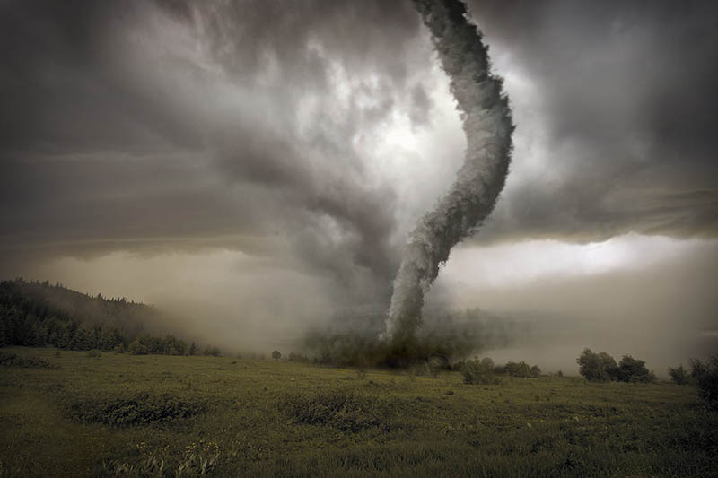
A strong wind which spins and moves across the ground.
T O R N A D O

Slide 3
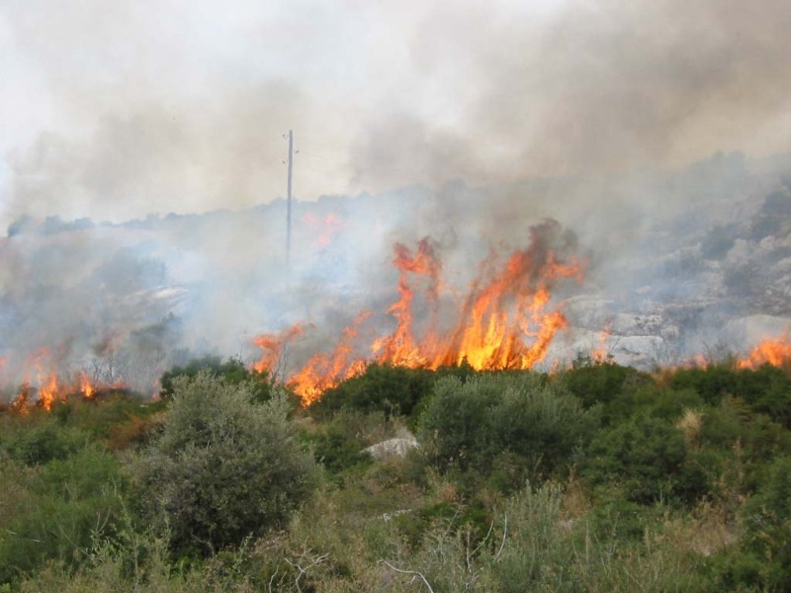
The destructive burning of a building, or a forest.
F I R E

Slide 4
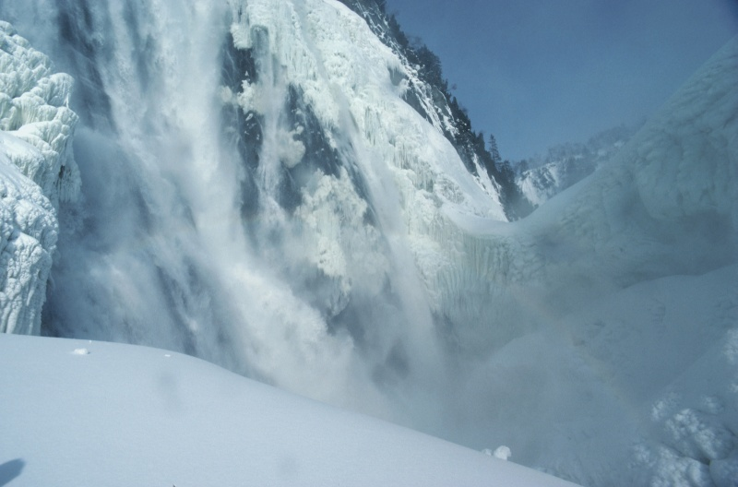
A large mass of snow that suddenly falls down the side of a mountain.
A V A L A N C H E

Slide 5
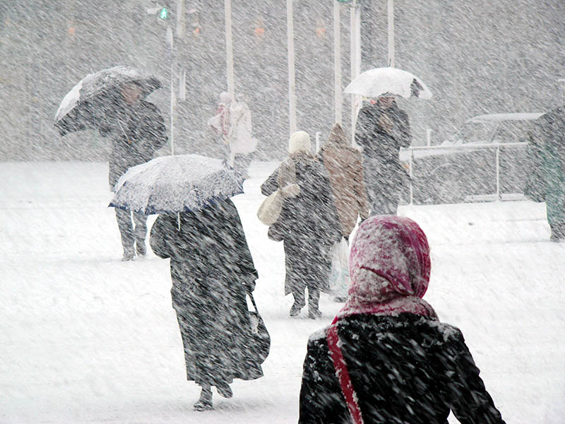
A storm with a lot of snow
and strong winds.
B L I Z Z A R D

Slide 6
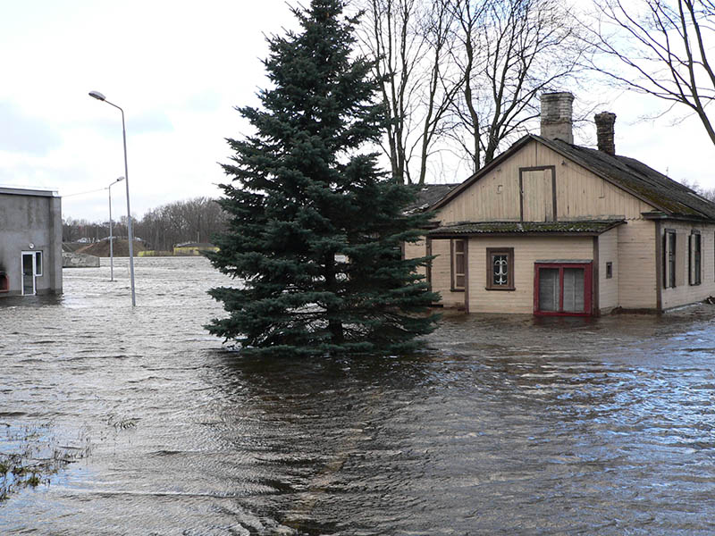
Water covering the land
that is usually dry.
F L O O D

Slide 7
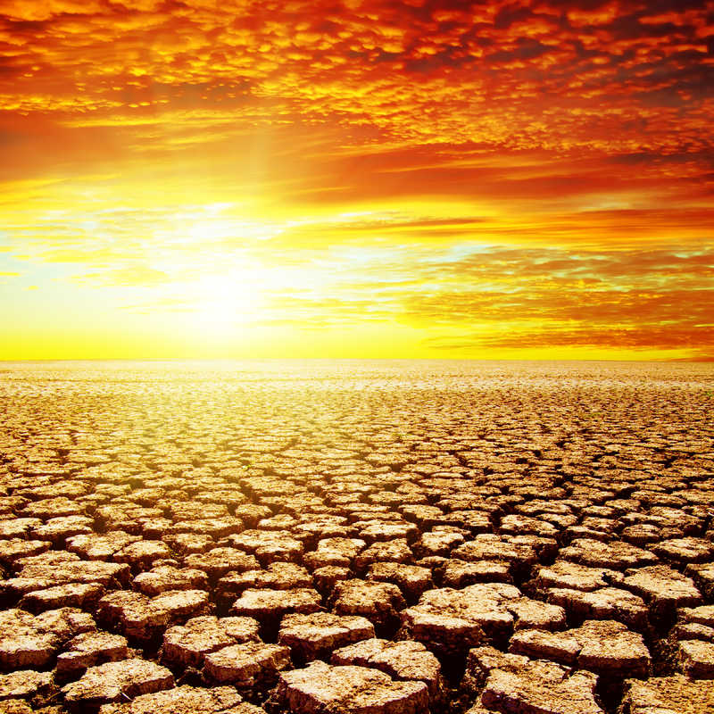
A long period of time without rain.
D R O U G H T

Slide 8
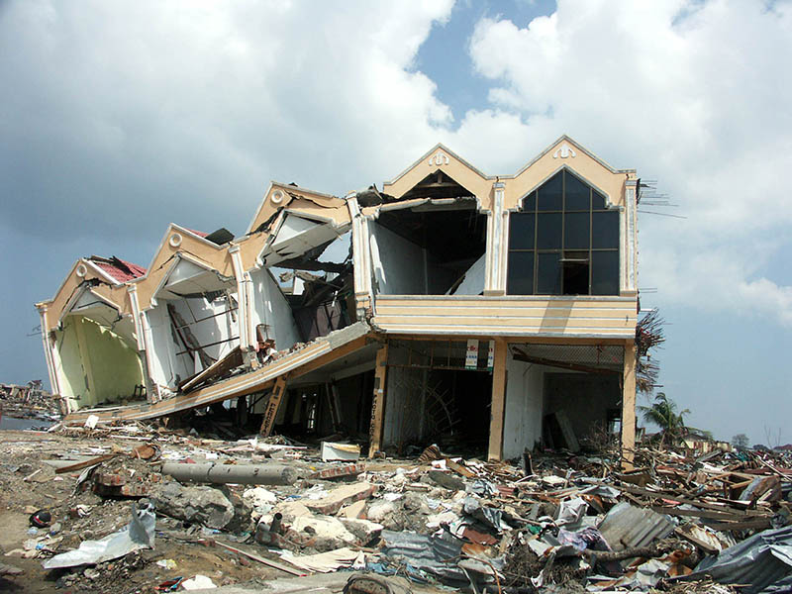
A sudden shaking of the ground.
E A R T H Q U A K E

Slide 9
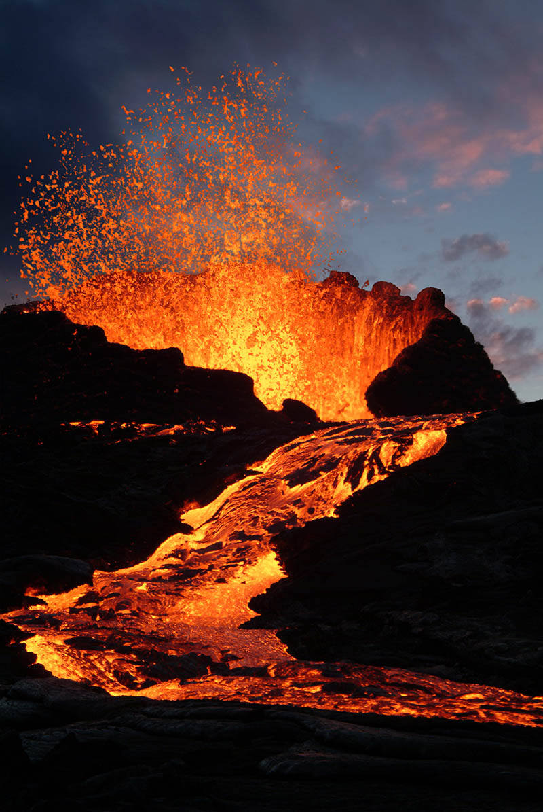
When a volcano explodes,
lava and ash come out of it.
V O L C A N I C E R U P T I O N

Slide 10
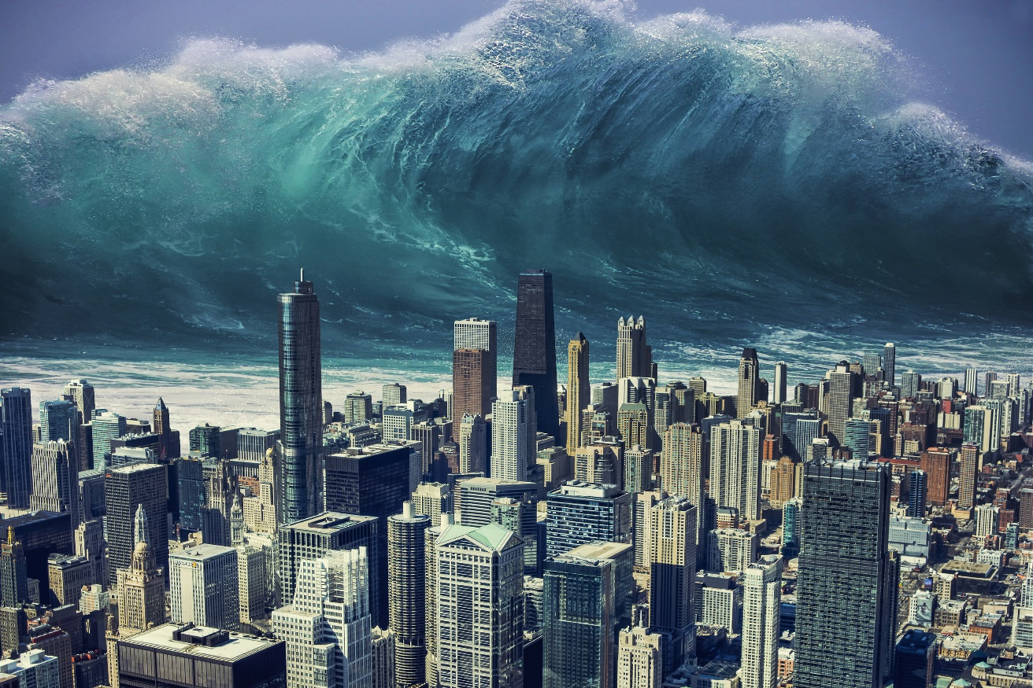
A very large seawave which can destroy buildings.
T S U N A M I

Slide 11
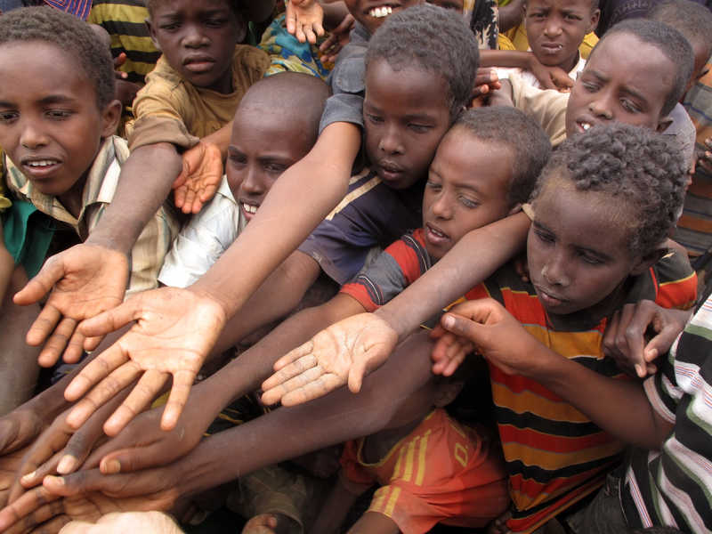
A situation in which many people do not have enough food to eat
F A M I N E

